Slide 1

TEKATHON-3.0- 2024
Problem Statement ID: SIH1638
Problem Statement Title: AI-Driven Crop Disease Prediction and Management System
Theme: Disease Prediction
PS Category: Software
Team Name: CodeSmasher

Slide 2

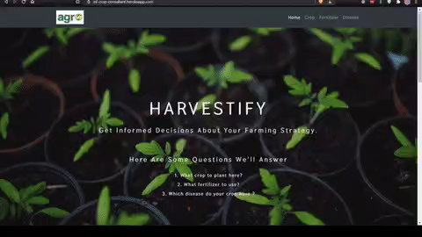
Interactive Job and Internship Platform
Proposed Solution
Designing an AI-Driven Crop Disease Prediction and Management System involves integrating various technologies and methodologies to enhance agricultural productivity and disease management. Below is a proposed solution outline for such a system: Key features include:
1) Objective
To develop an AI-powered system that predicts crop diseases early, provides actionable insights, and recommends management practices to optimize crop health and yield.
2) Key Components
Data Collection
Sensors and IoT Devices: Deploy sensors in fields to collect data on soil moisture, temperature, humidity, and other environmental factors.
Satellite and Drone Imagery: Use drones and satellites to capture high-resolution images of crops for visual analysis.

Slide 3
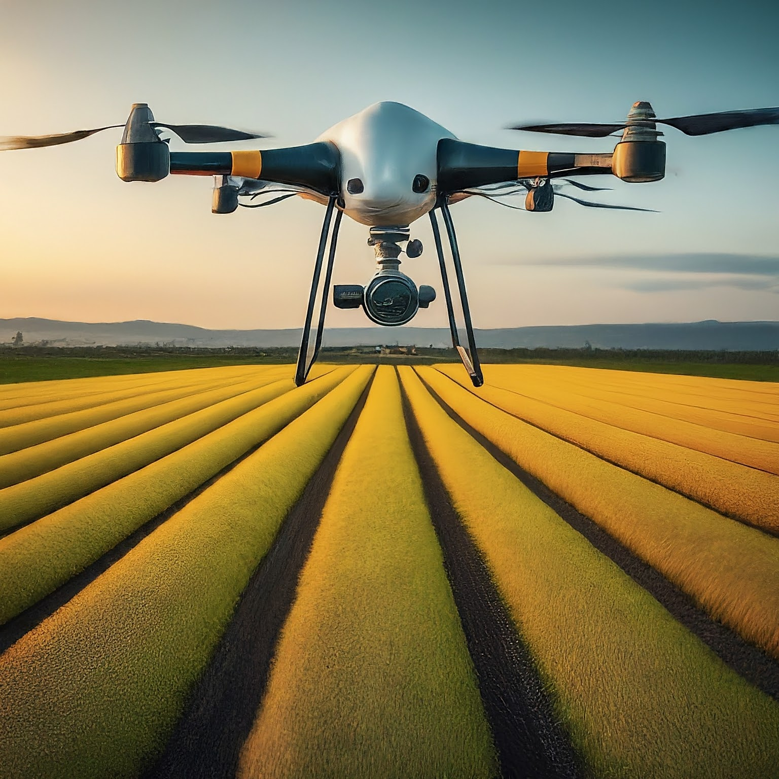
TECHNICAL APPROACH
1) Data Acquisition
The system leverages a wide range of data sources, including images, sensor readings, and historical records, to create a comprehensive dataset.
2) Model Training
Machine learning algorithms are trained on this dataset to identify patterns and predict the likelihood of disease outbreaks.
3) Early Detection and Alerting
The system analyzes real-time data and provides timely alerts to farmers, allowing for immediate intervention and mitigation.
Flowchart

Slide 4
FEASIBILITY AND VIABILITY
Accuracy and Reliability
Rigorous testing and validation ensure the accuracy and reliability of the system's predictions, providing farmers with confidence in the results.
Funding and Investment
Funding Sources: Identify potential funding sources, including government grants, agricultural subsidies, and venture capital.
Partnerships: Explore partnerships with agricultural organizations, research institutions, and technology providers.
Scalability
The system's modular design and cloud-based architecture enable easy scaling to accommodate diverse farming operations and geographical locations.
Cost-Effectiveness
The system's ability to prevent significant crop losses through early intervention contributes to cost savings and increased profitability for farmers.
Technical Skills
Expertise: Evaluate the availability of skilled personnel for data science, machine learning, software development, and agricultural expertise.
Training: Provide training for users and developers to effectively utilize and maintain the system.

Slide 5

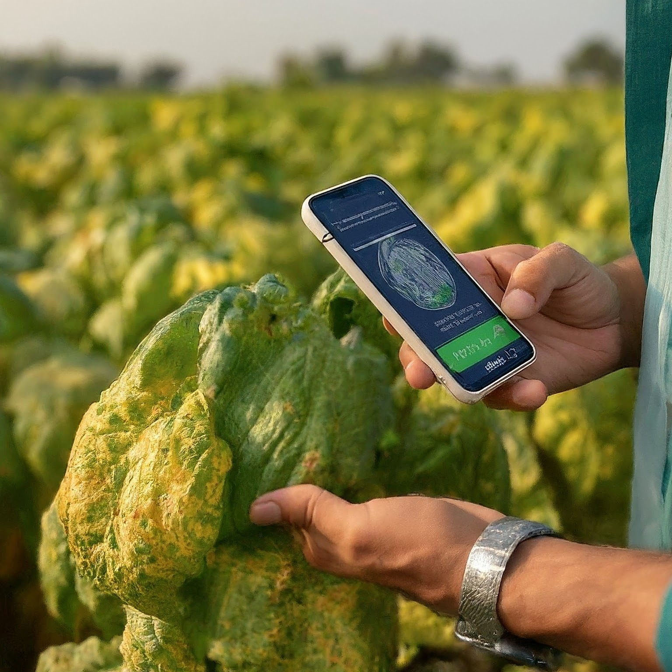
IMPACT AND BENEFITS
Improved Yield
By preventing and mitigating disease outbreaks, the system helps ensure healthy crops and higher yields, boosting agricultural productivity.
Reduced Pesticide Use
Early detection and targeted intervention minimize the need for broad-spectrum pesticides, reducing environmental impact and promoting sustainable agriculture.
Enhanced Food Security
By contributing to increased food production and reduced food waste, the system plays a vital role in enhancing food security and ensuring a reliable food supply.
Research and Referenc
Enhanced Decision-Making
Data-Driven Insights: Farmers receive actionable insights based on data from various sources (e.g., sensors, satellite imagery), enabling more informed decision-making.
Predictive Analytics: The system can forecast disease outbreaks and environmental conditions, helping farmers plan and prepare more effectively.

Slide 6
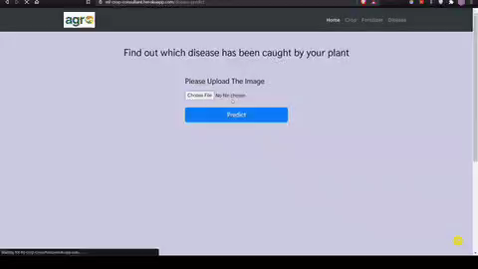
RESEARCH AND REFERENCES
Academic Papers and Research Articles
Deep Learning for Plant Disease Detection and Classification
Title: "Deep Learning for Plant Disease Detection and Classification: A Survey"
Authors: A. S. Ganaie, K. S. Yoon, H. D. Lee, M. G. Kang, H. H. Kim
Journal: Sensors
Link: Deep Learning for Plant Disease Detection.
Machine Learning Applications in Agriculture
Title: "Machine Learning for Agriculture and Crop Disease Management: A Review"
Authors: G. Chen, Y. Liu, X. Zhu, H. Xu
Journal: Journal of Computational Science
Link: Machine Learning in Agriculture.
Precision Agriculture and Remote Sensing
Title: "Remote Sensing and Precision Agriculture: A Review"
Authors: A. R. Ghosh, B. E. F. M. Muller
Journal: Remote Sensing
Link: Remote Sensing and Precision Agriculture.
AI in Crop Disease Management
Title: "Artificial Intelligence in Agriculture: A Review"
Authors: S. Singh, A. G. Murthy, P. Sharma
Journal: AI Open
Link: AI in Agriculture

Slide 7


